Slide 1
US Bicyclist Fatalities
Melanie Adams, Jodie Carlson,
Sam Etten, Norean Gardner,
and Brian Rolf

Slide 2
Data Set – 2017 FARS
A primary objective of the National Highway Traffic Safety Administration (NHTSA) is to reduce fatal motor vehicle traffic crashes. An initiative created by NHTSA is to collect data to support the development, implementation, and assessment of highway traffic to reduce fatalities.
Data points in the set: To qualify as a FARS (Fatality Analysis Reporting System) case, the crash had to involve a motor vehicle traveling on a trafficway customarily open to the public, and must have resulted in the death of a motorist or a non-motorist within 30 days of the crash.
Notes:
Brian

Slide 3
What Factors Contribute to a Higher
Risk of Bicycle Fatalities?
Hypothesis analyzed:
Bicyclists travelling during rush hour in urban areas in the evening are at a higher risk of fatal accidents.
Key factors considered:
Time of day
Type of environment
Notes:
Brian

Slide 4
What Factors Contribute to a Higher
Risk of Bicycle Fatalities?
Other factors considered:
Day of the week
Gender of bicyclist
Involvement of alcohol
Direction of travel (bicyclist vs. traffic)
Cause of accident
Weather conditions
Notes:
Norean

Slide 5
Data Fields of Interest
STATE.x
ST_CASE
PER_NO
PBPTYPE
PBAGE
PBSEX
PBCWALK
PBSWALK
PBSZONE
BIKECYTPE
BIKELOC
BIKEPOS
BIKEDIR
BIKECGP
DAY
MONTH
YEAR
DAY_WEEK
HOUR
MINUTE
RUR_URB
FUNC_SYS
TWAY_ID
TWAY_ID2
LATITUDE
LONGITUD
HARM_EV
MAN_COLL
TYP_INT
WRK_ZONE
REL_ROAD
LGT_COND
WEATHER1
WEATHER2
WEATHER
SCH_BUS
CF1
CF2
CF3
FATALS
DRUNK_DR
date (created)
TIME (created)
Notes:
Norean
Just define the most used fields
Squares around most used

Slide 6

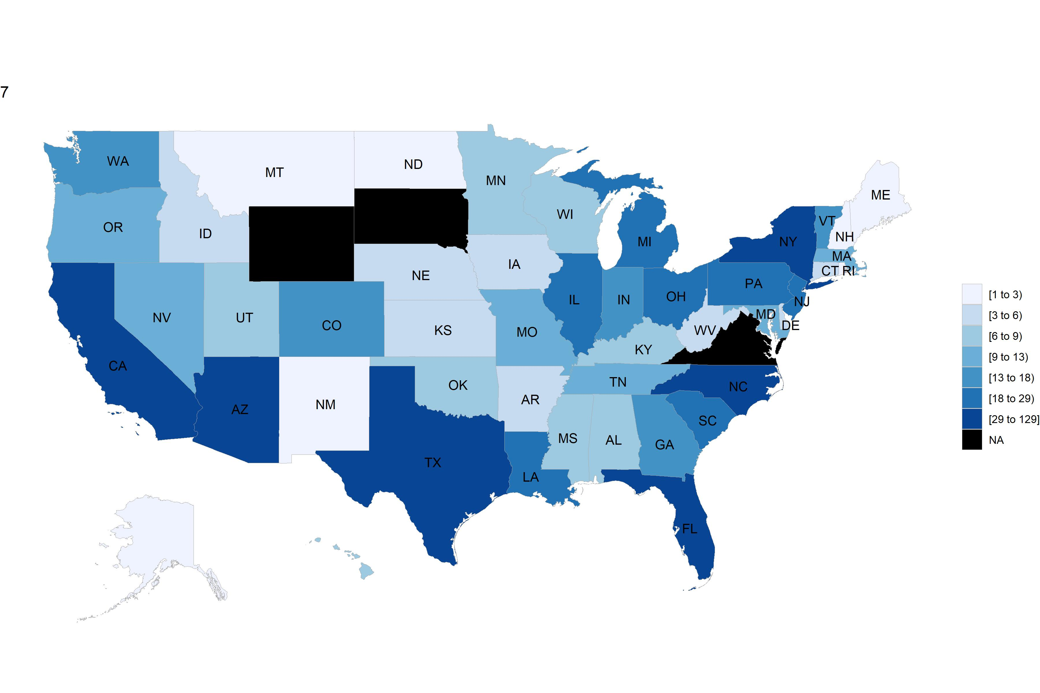
Fatalities by State
Notes:
Melanie

Slide 7
Fatalities by State – Top 5
State | Number of Fatalities in Data
California | 129
Florida | 127
Texas | 60
New York | 49
Arizona | 33
State | Fatalities per 1M Pop.
Florida | 5.88
Arizona | 4.52
California | 3.25
New York | 2.51
Texas | 2.07
VS.
Notes:
This correlates with our hypothesis that more urban areas are susceptible to bicycle crashes.
Melanie
State
Fatalities per 1M Pop.
California
39.7 M
Texas
29.0 M
Florida
21.6 M
New York
19.5 M
Pennsylvania
12.8 M

Slide 8
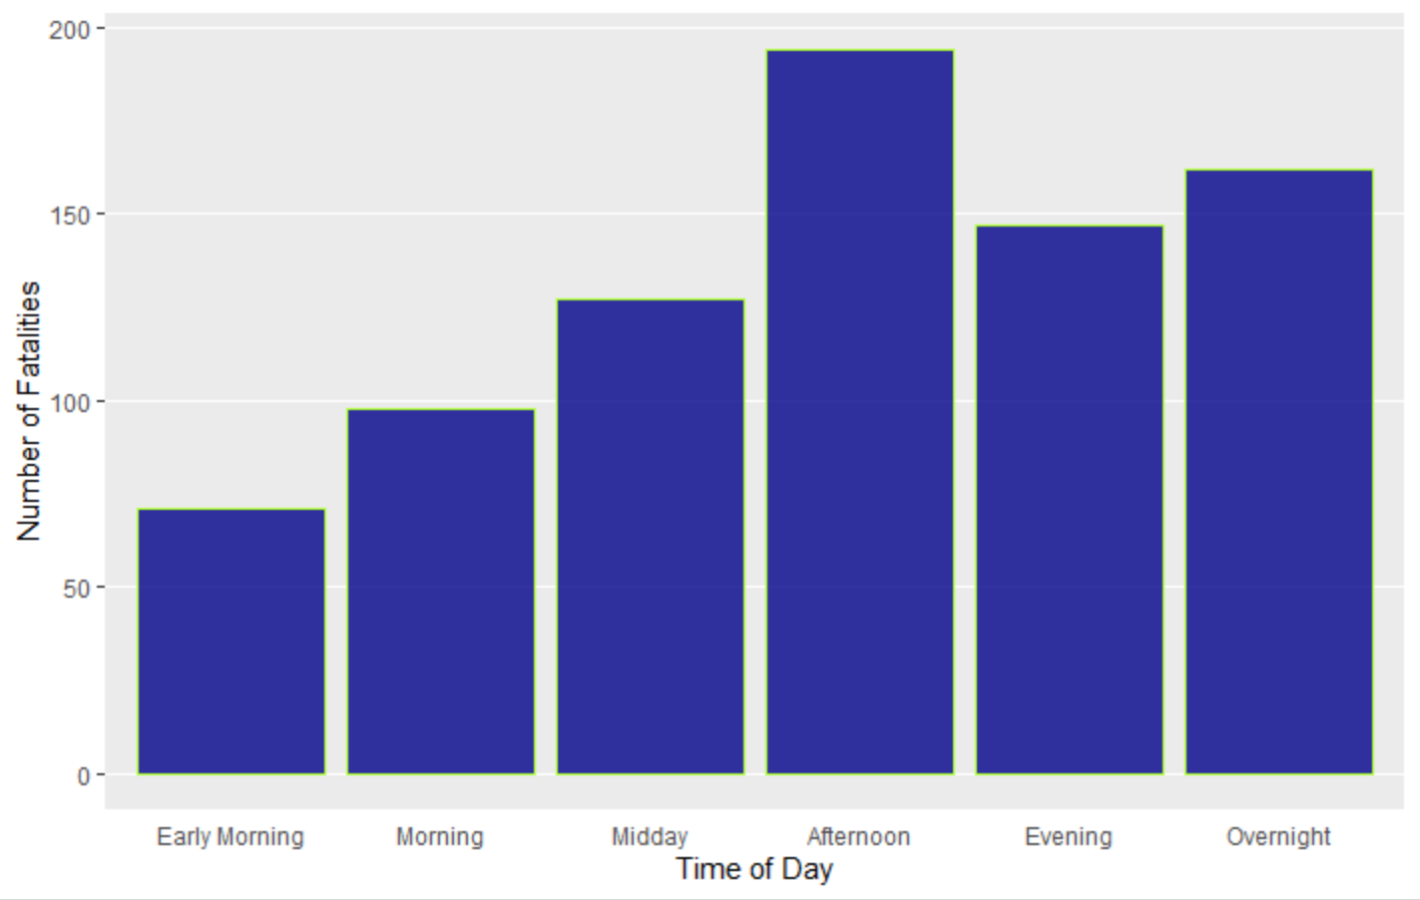
Fatalities by Time of Day
Most bicycle fatalities seen in the afternoon (3pm – 6pm)
Notes:
Jodie
When presenting, can share the times that correspond to each. Shows highest number during 3-6pm (ties in with hypothesis of more during evening rush hour window, which is generally around 4-6pm)

Slide 9
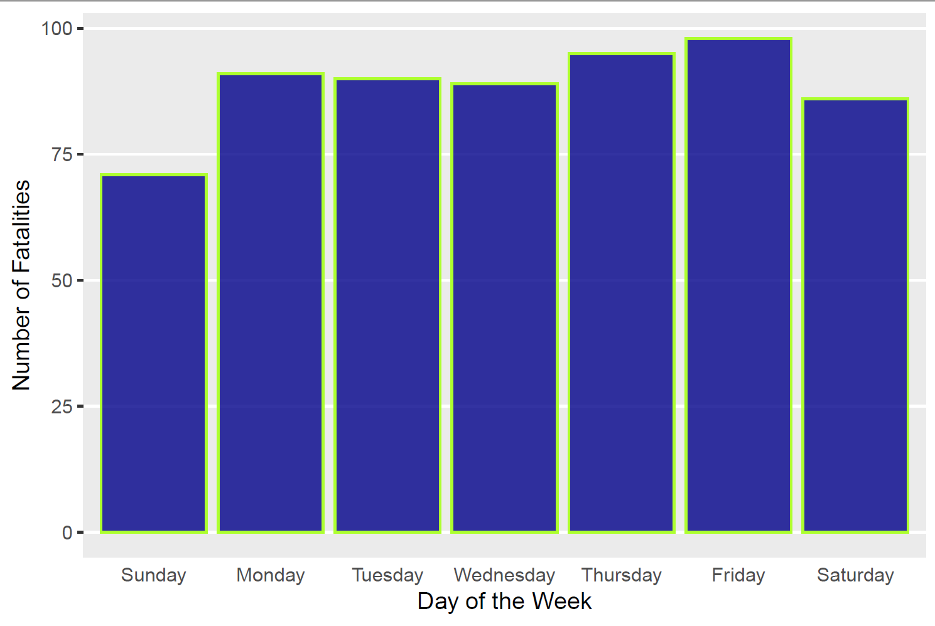
Fatalities by Day of the Week
Slightly more fatalities seen on Friday, with fewer occurring on the weekends
Notes:
Jodie

Slide 10
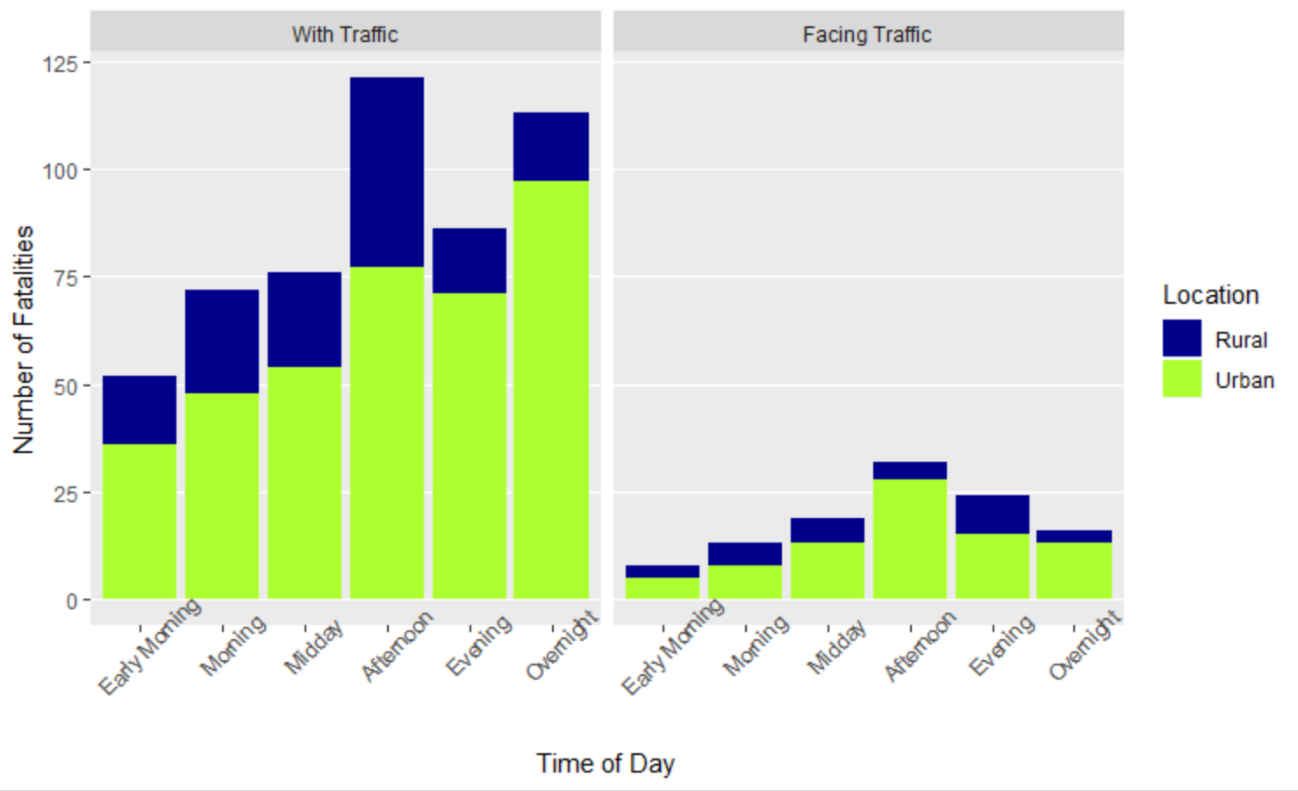
Fatalities by Time of Day, Type of Location, and Bicycle Direction
Significantly more fatalities in Urban areas and when the bicycle is riding with traffic
Notes:
Jodie
Shows higher numbers in urban areas and many more when the bicycle is traveling the same direction as traffic

Slide 11
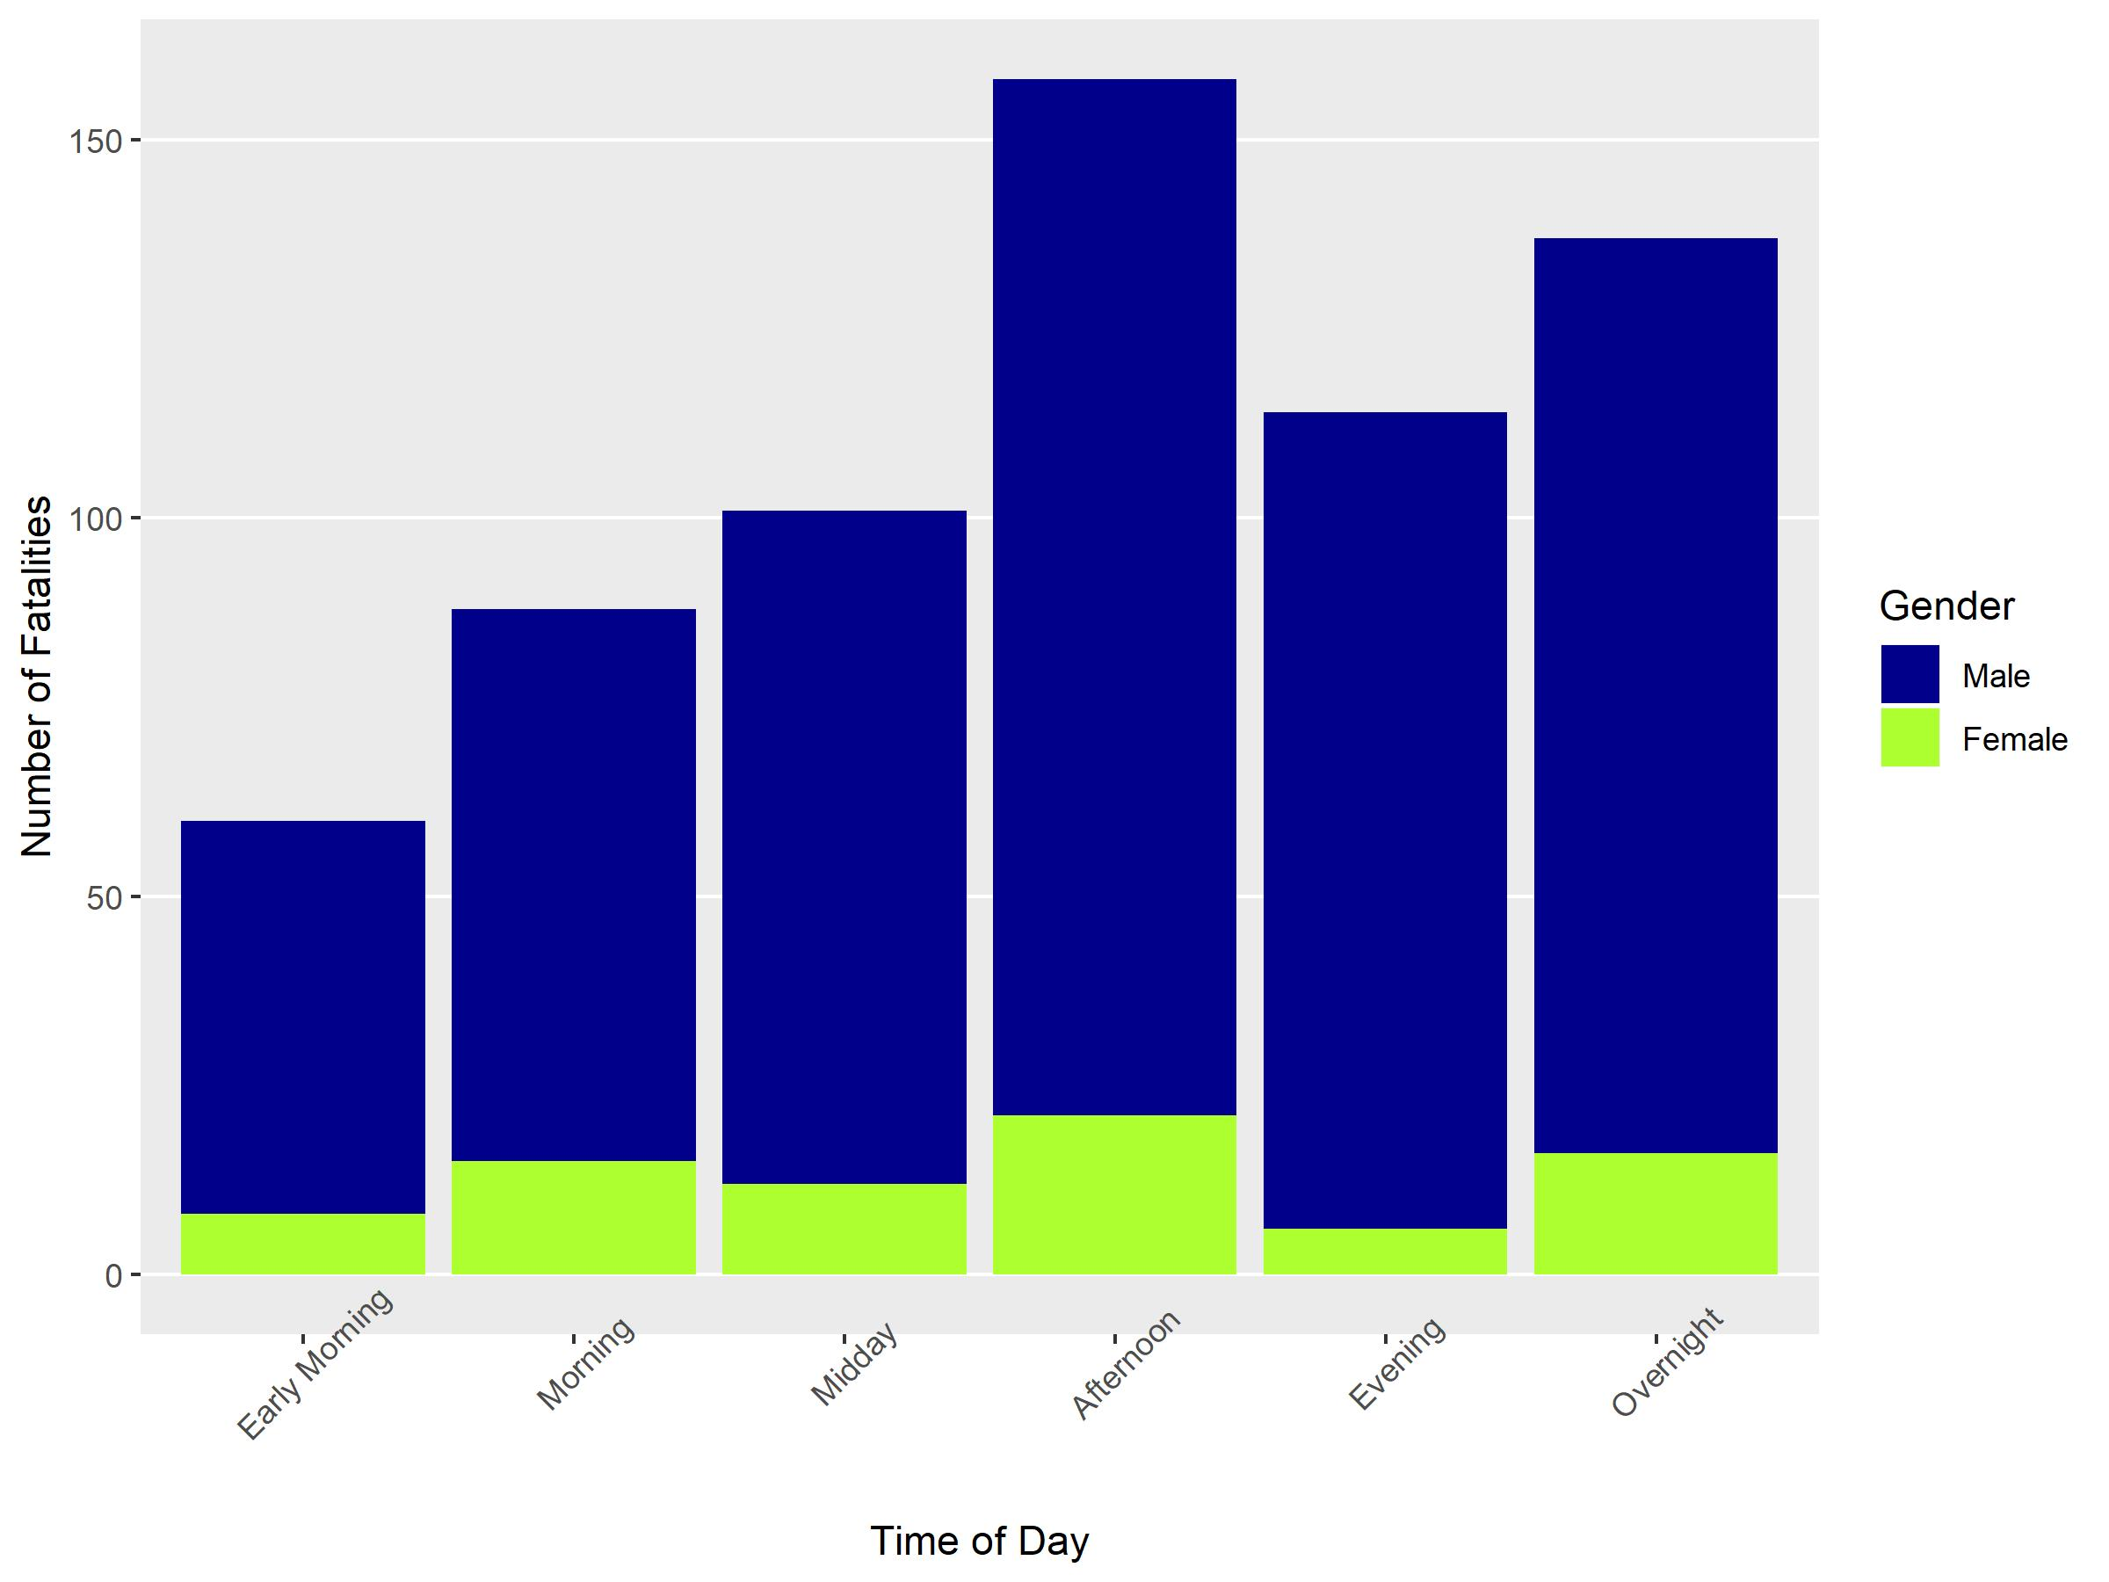
Time of Day vs Gender
More male fatalities than female fatalities.

Slide 12
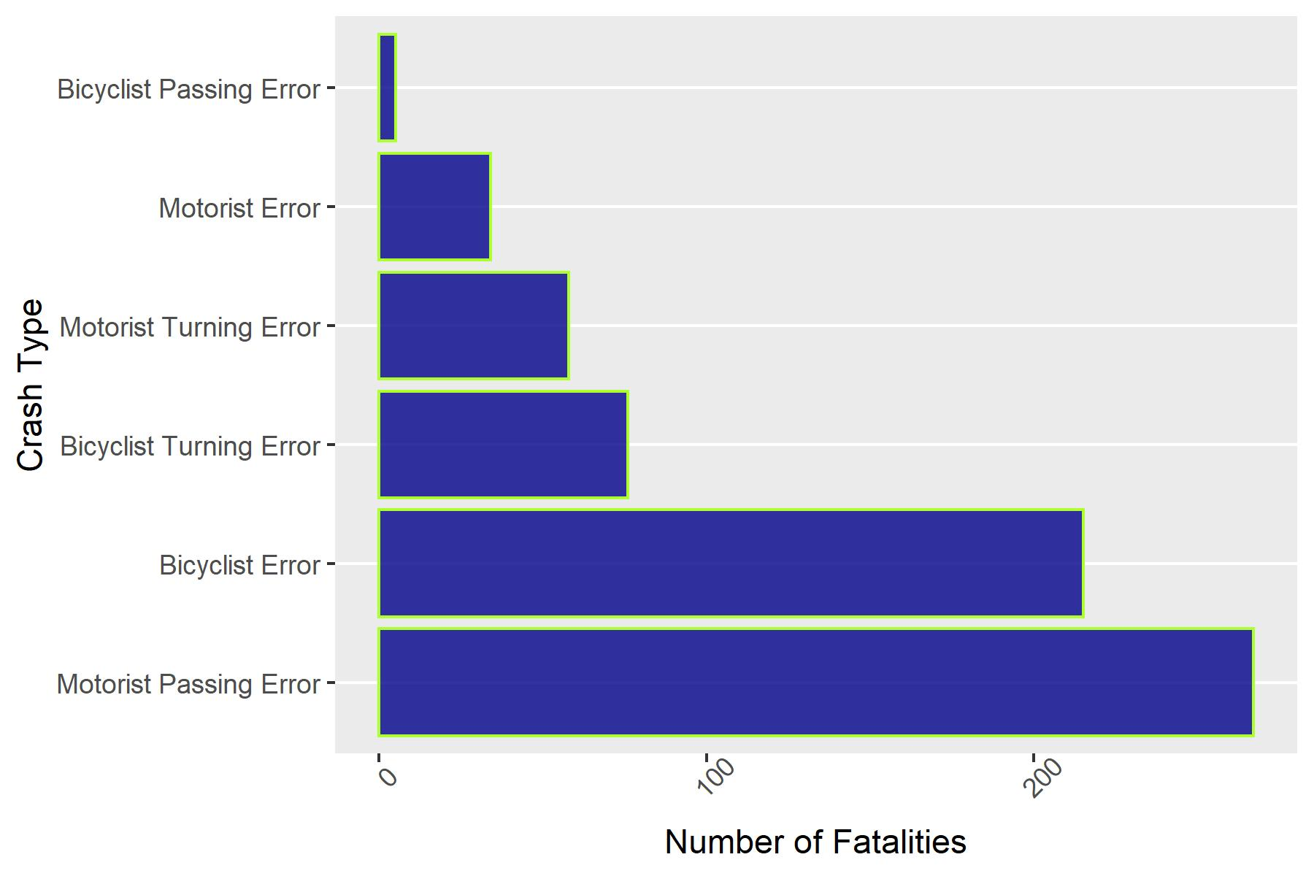
Crash Type
Motorist Error and Bicyclist Error are comparable.
Notes:
Brian

Slide 13
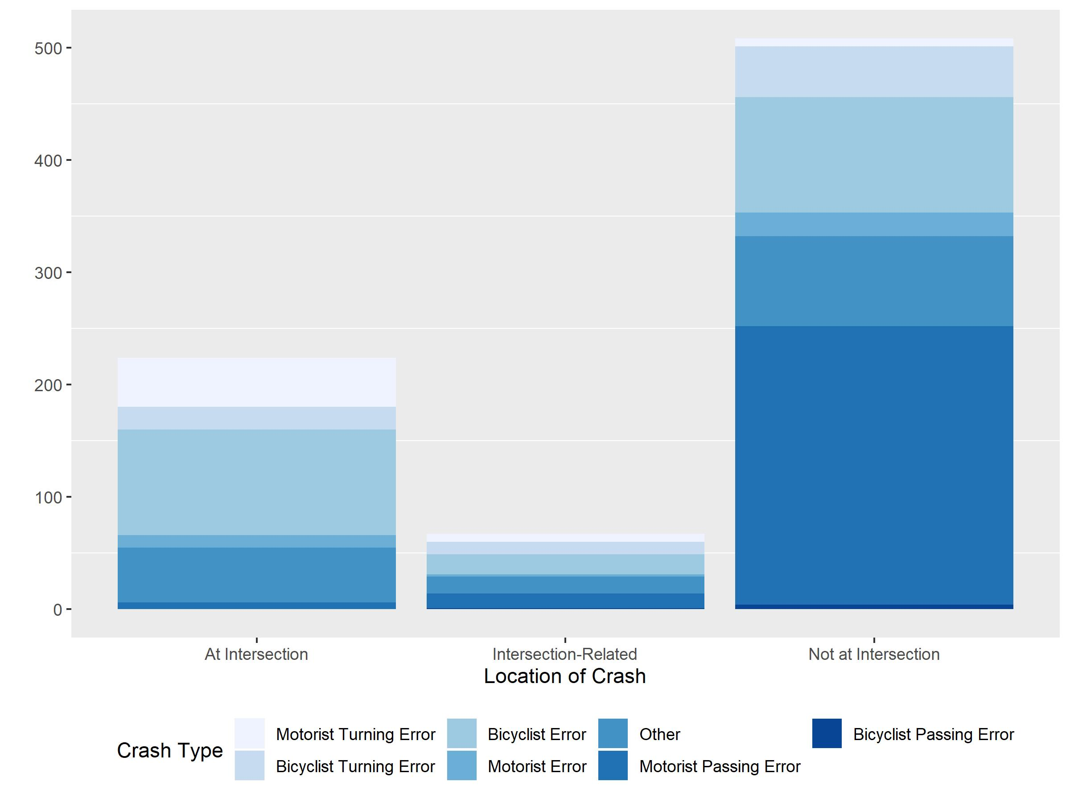
Crash Location
At intersections, more commonly Bicyclist Error. Not at intersections, more commonly Motorist Error.
Notes:
Brian

Slide 14
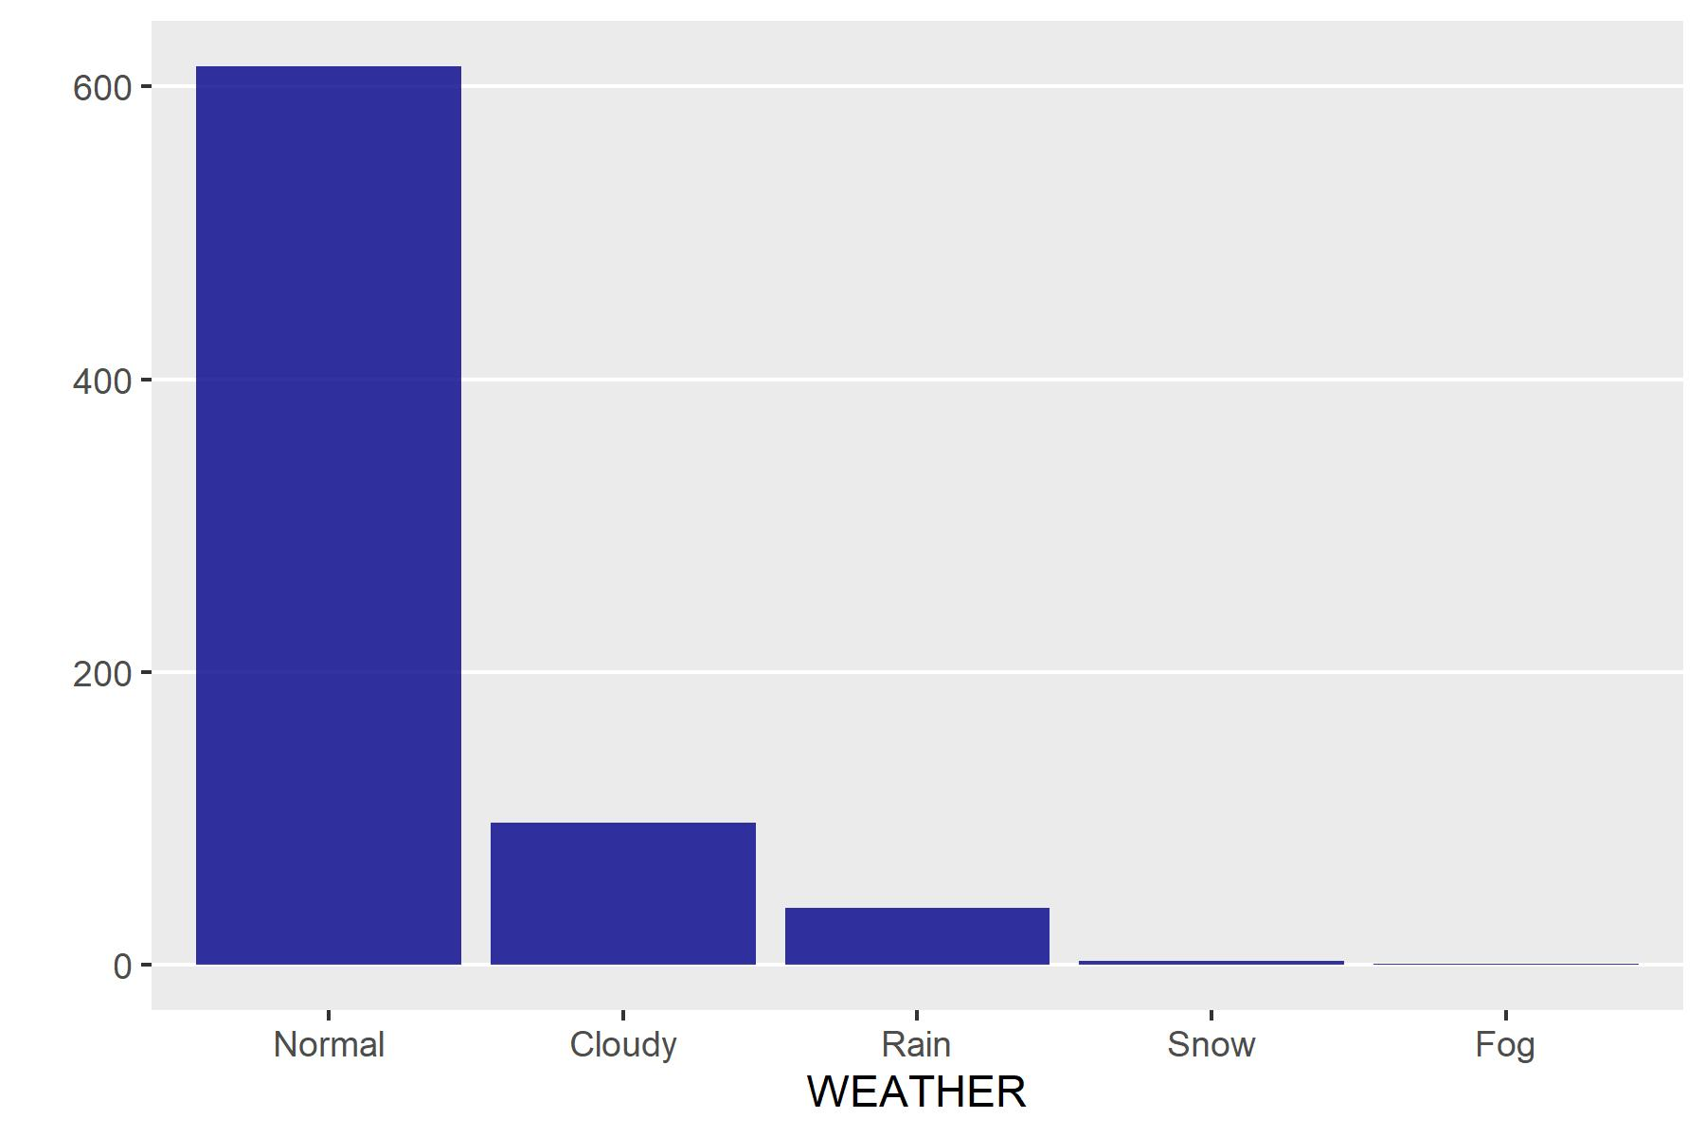
Weather
Inclement weather didn’t seem to affect fatalities
Notes:
Sam

Slide 15
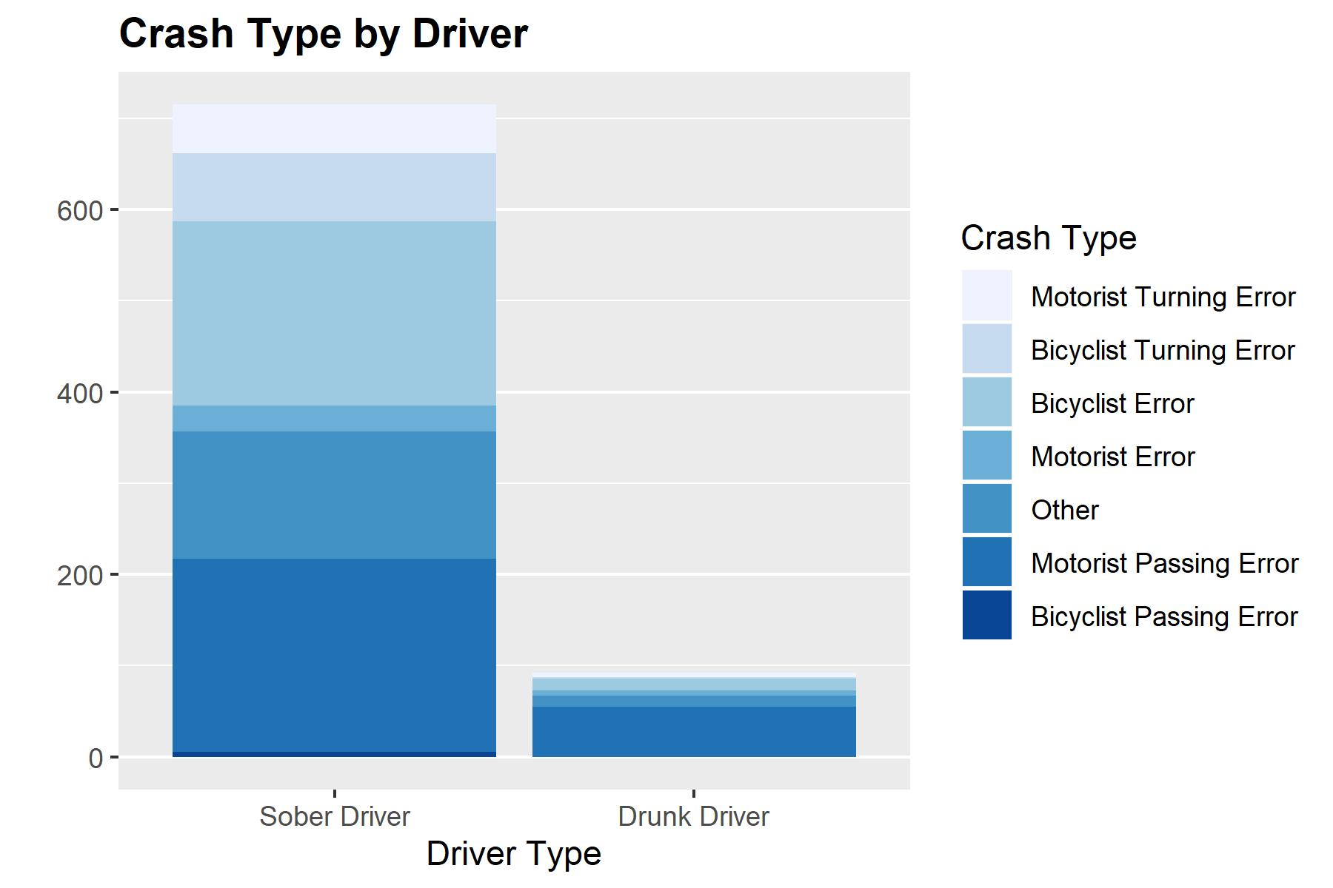
Drunk Driving
Drunk drivers weren’t common in accidents.
Notes:
Sam

Slide 16
Key Findings
Hypothesis analyzed:
Bicyclists traveling during rush hour in urban areas in the evening are at a higher risk of fatal accidents.
Notes:
Was our hypothesis right?
Sam

Slide 17
Key Findings – Continued
Surprises
Overnight fatalities would be so high
Not much difference regardless of day
Arizona is 5th in number of fatalities but 2nd in fatalities per million residents
Notes:
Function?

Slide 18
Conclusion
What we found:
Urban vs Rural
Evening Rush vs Rest of the Day

Slide 19
Thank You
Melanie Adams, Jodie Carlson, Sam Etten, Norean Gardner, and Brian Rolf

